Slide 1



Facebook Splash
Android study

Slide 2

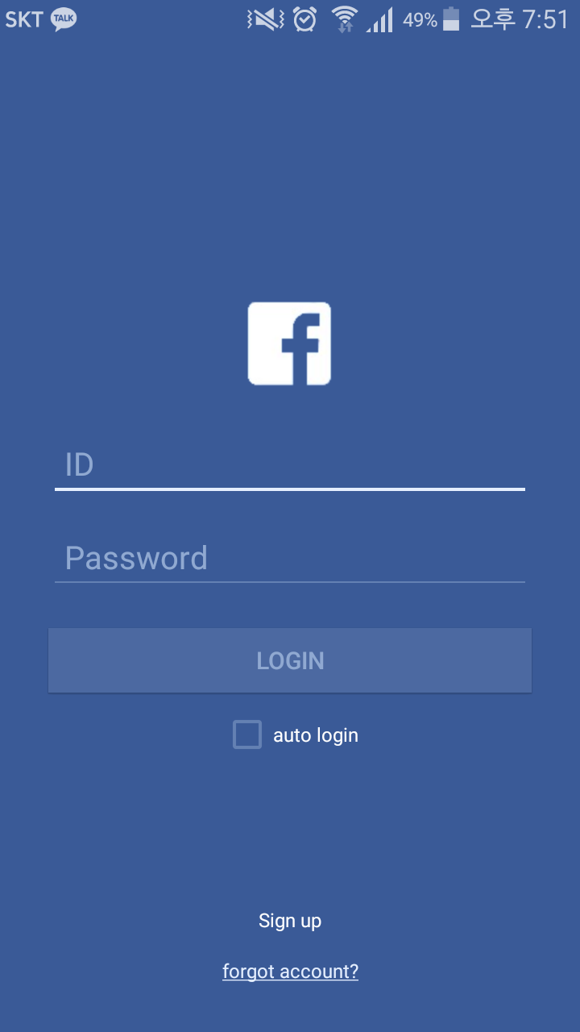
Goal
After 1300ms

Slide 3
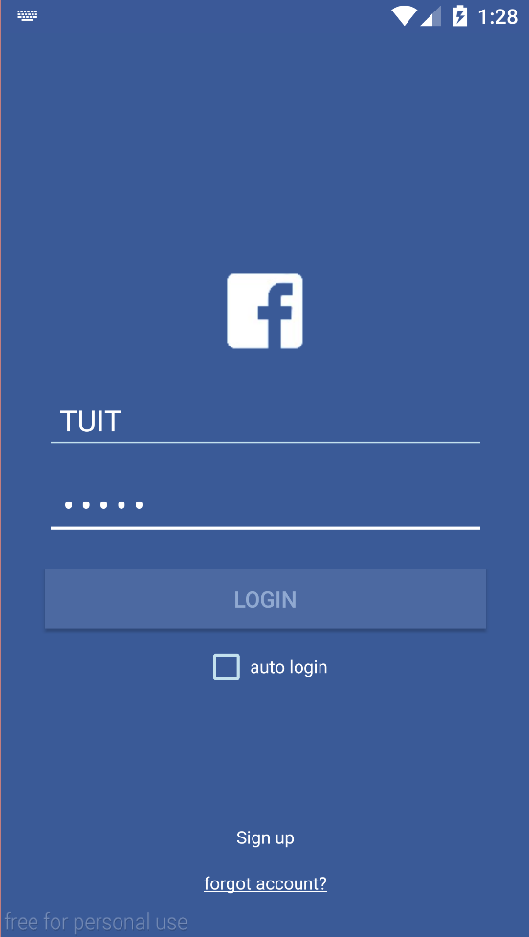

Goal
Send information
between Activity

Slide 4
Intent

Slide 5

Kind of message object.
Explicit Intent
Implicit Intent

Slide 6
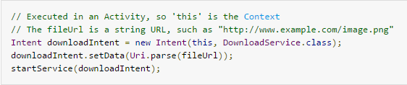
Explicit Intent

Slide 7
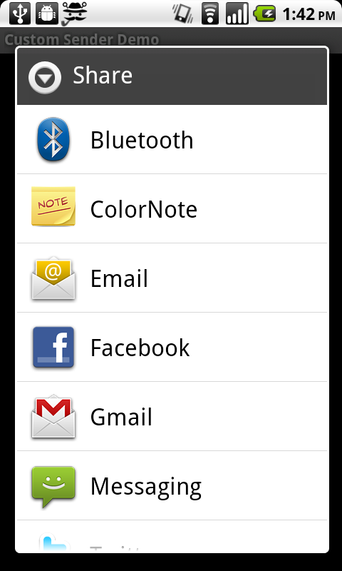
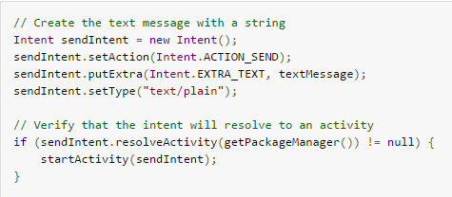
Implicit Intent

Slide 8
Thread

Slide 9
A Little about Thread
Process
vs
Thread
An instance of a computer program that is being executed
A thread is a lightweight process which exists within a program and is executed to perform a special task.
Several threads of execution may be associated with a single process.

Slide 10
A Little about Thread
one Process, many Threads
One
Process
Thread1
Thread2
Thread3

Slide 11
A Little about Thread
Even though it appears to us that many programs run at the same time, in reality, only one process is able to use a CPU core at a time.
So Threads run in one process at same time !

Slide 12
Thread in Android
Main Thread
vs
Sub Thread
Can Control UI
Made by us
Cannot Control UI

Slide 13
Handler

Slide 14
Handler
Main Thread
Handler
Sub Thread

Slide 15
Method of Handler class
postDelayed(Runnable r, long delayMillis)
post(Runnable r)
sendMessageDelayed(Message msg, long delayMillis)
sendMessageAtTime(Message msg, long uptimeMillis)

Slide 16
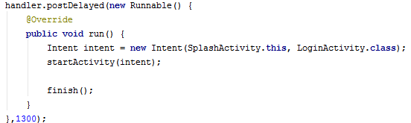
postDelayed
(Runnable r, long delayMillis)

Slide 17
Abstract method

Slide 18
public abstract void setValue(int value);
An abstract method has no body and must be overridden in a subclass.
expects to be overridden in a subclass.
in subcalss,
@Override
public void setValue(int value){ … }

Slide 19
interface

Slide 20
public abstract void setValue(int value);
An interface is similar to an abstract class that has all abstract methods.
Only one class can be extended in Java but many interface can be implemented .
public interface InterfaceName
{
(Method headers...)
}

Slide 21
Runnable interface

Slide 22
Method of runnable interface
run() //abstract void
The Runnable interface should be implemented by any class whose instances are intended to be executed by a thread. The class must define a method of no arguments called run.

Slide 23
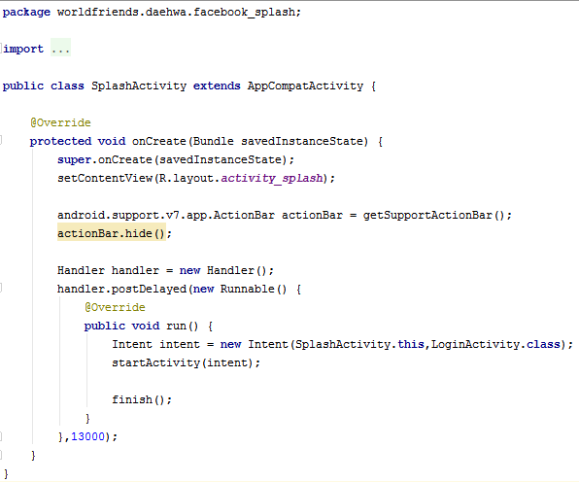
Whole Code

Slide 24
Do you remember?
Please recall this file!

Slide 25
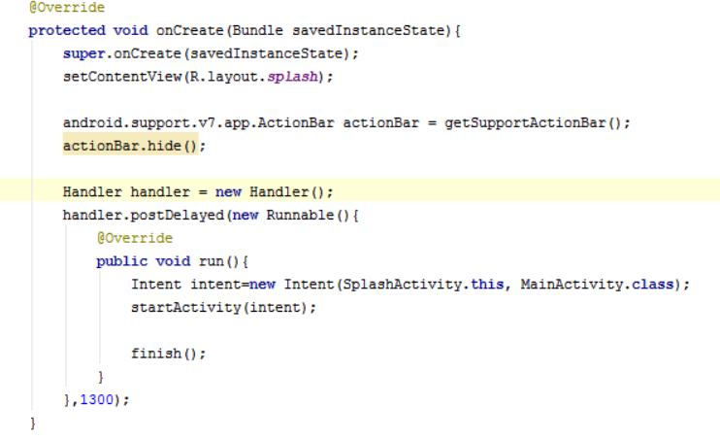

2. Parent class has method ‘getSupportActionBar()’ : get address of action bar of present activity
1. Make object of android.support.v7.app.ActionBar class
3. ActionBar class has () method ‘hide’

Slide 26
Recall: All objects are like pointer in Java.
Handler handler; is not allocated memory like a pointer. so should be written as Handler handler=new Handler();
Handler has method ‘postDelayed’. It has two parameters : runnable object and delayTime.

Slide 27
The method run in Runnable interface should be overridden.

Slide 28
Constructor of Intent Class need two arguments in this case: Intent(Context packageContext, Class<?> cls)

Slide 29
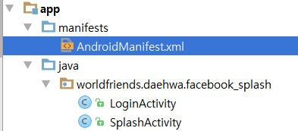
We should tell Manifest that we made new Activity

Slide 30
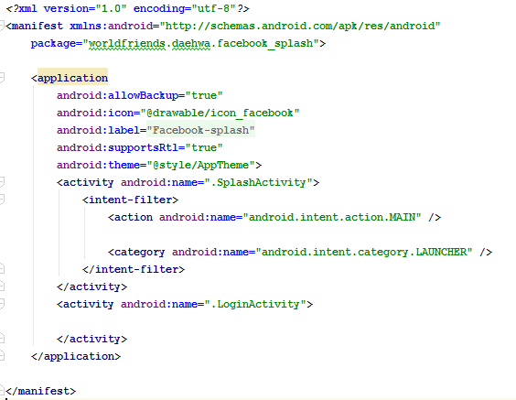

Slide 31
Intent, again

Slide 32
Method of Intent
putExtra(String name, String value)
putExtra(String name, String[] value)
putExtra(String name, boolean value)
putExtra(String name, int value)
getExtra()
getStringExtra(String name) getIntExtra(String name, int defaultValue)
getClipData()

Slide 33
putExtra
(String name, String value)

Slide 34
getExtra()
getStringExtra(String name)

Slide 35

Download skeleton
https://github.com/daehwa/world-friends-Uzbekistan-android/

